Slide 1

Requirement Analysis Report
Road Sign And Road Map Mobile Notification Application
Group 5

Slide 2
Agenda
Introduction
Acceptance Test Plan
01
04
Objective/Methodology
Conclusion
02
05
Requirements Classification
03

Slide 3

Introduction
This report, compiled by Group 5, details the planned functional, non-functional, user, system, and legal requirements, alongside the methodology and a proposed test plan

Slide 4

Objective objective​ objective Methodology methodology methodology methodology

Slide 5

Objectives
Methodology
To identify and Prioritize user needs
To define the planned requirements for the proposed application
To establish a clear framework for the design and development framework
Stake Holder Interview
Document Review
Comparative Legal Benchmarking
Risk Assessment Workshops

Slide 6

Requirements Requirements Requirements Classification Classification Classification Classification

Slide 7
Functional Requirements
1 Road Sign Directory
3
Crowd Reporting
5
Customizable Notification
7
Offline Mode
6
Location Sharing
2 Real-Time
Alerts
4
GPS Navigation

Slide 8
Non-Functional Requirements
1
2
3
Security
Reliability
Performance
4
5
6
Scalability
Usability
Compatibility

Slide 9

System Requirements
01
Minimum Smartphone Spec
02
Back-End Cloud Storage
03
Offline Mode
04
API Integration

Slide 10
User Requirements
1
2
3
4
Localization
Partnerships
Safety
Accessibility

Slide 11



Prioritized Requirements
Voice Alerts for Traffic/ Accidents
Road Sign Directories
Real Time Road Condition Alerts
Crowd Reporting Interface
Offline Mode

Slide 12
Human resources slide 4
Data Retention Policy
User Consent For Local Sharing
Accessibility Standards
Compliance With Local Data Privacy Laws
Emergency Service Compliance
Legal And Regulatory Requirements

Slide 13

Acceptance Test Plan

Slide 14
Test Team Approach
Preparation
Execution
Define the acceptance criteria and design the test cases.
Execute the test cases and document the results.
Reporting
Retesting And Regression Testing
Report the test results to the stakeholders
If any defects are identified, they should be fixed and the affected test cases should be retested.
Sign-Off
Upon successful completion of all tests, the stakeholders sign off on the acceptance of the application

Slide 15
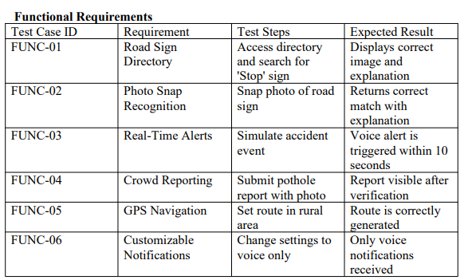
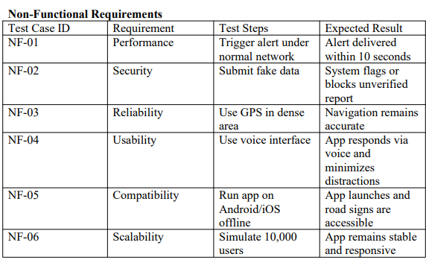
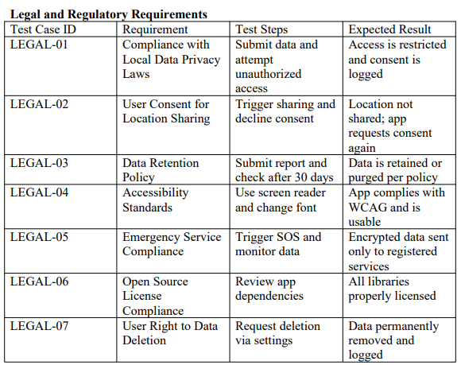
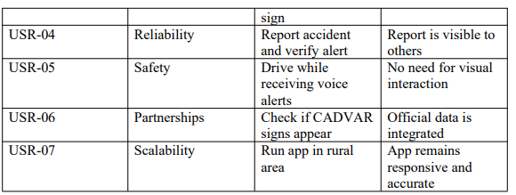
Test Cases

Slide 16

Conclusion

Slide 17
Thank You

